Slide 1

MODULES

Slide 2
SESSION OVERVIEW:
DEFINITION & TYPES
IMPORT STATEMENT
PACKAGE
PYTHON NUMBERS
TYPE CONVERSION
MODULES

Slide 3
DEFINITION
Modules : a File Containing Python Code which can be Imported.
Which is Similar to Header Files in C,C++ which can be Included
Eg : #include<stdio.h> #include<iostream.h> #include<conio.h>
Uses :
Reusability of Code
Code can be Imported instead of Copying it in any Program

Slide 4
TYPES
Built-in
User Defined
Python has a Ton of Standard Modules Available
To Check the Full list .
Go to the Drive Where Python is Installed -> Lib Directory

Slide 5
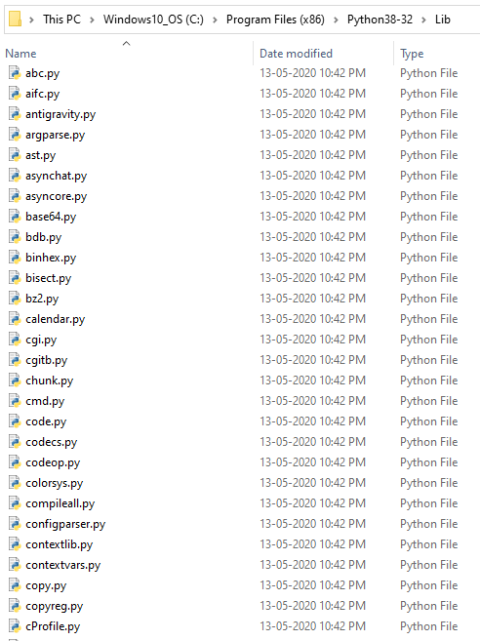
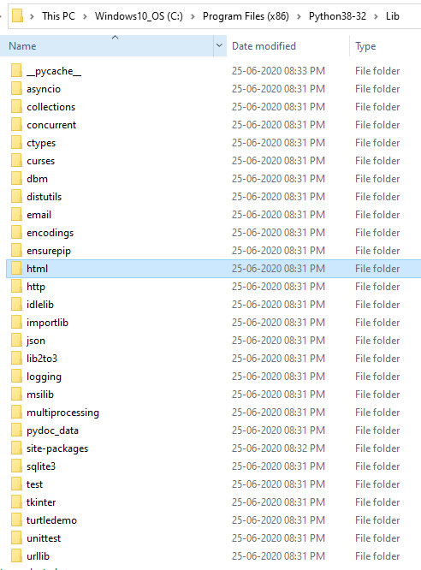

Slide 6

IMPORT STATEMENT
Import is similar to #include in C, C++.
This Enables us to reuse the code written in the Module without actually copying it.
SYNTAX: import <module_name>
We use the Dot Operator (.) to access the Functions in the Module
SYNTAX: <module_name>.<function_name>(<args>)

Slide 7
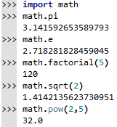
MATH MODULE

Slide 8


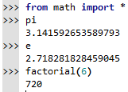
IMPORT WITH RENAMING
FROM ….. IMPORT
IMPORT ALL

Slide 9
USER DEFINED MODULES
The Modules Which is Created by the User can also be Imported and used in any program
Under the Condition that the Python File (Module) must be saved in the same Location where the Built-in Modules are placed.
That is in the Lib Directory

Slide 10
PYTHON PACKAGE
Package is a Collection of Modules
As we Have many modules
We place similar modules in 1 package
Different Modules in Different Packages
A Python Package can have Sub-Packages & Modules
A directory named _ _init_ _.py in order for Python to Consider it as a Package.
This is _ _init_ _.py is similar to Constructors.

Slide 11
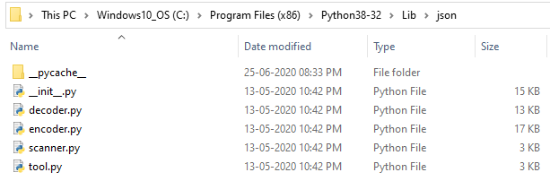
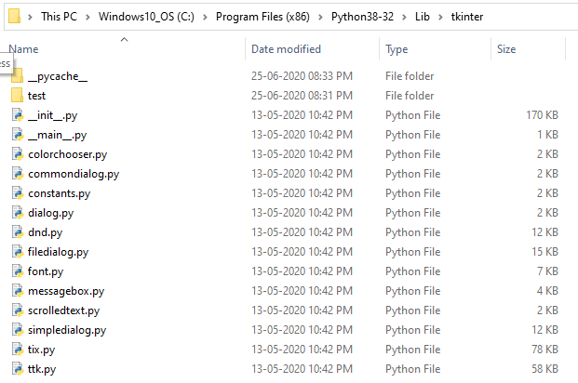

Slide 12
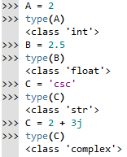

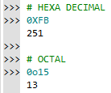
PYTHON NUMBERS

Slide 13
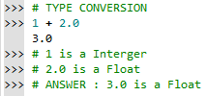
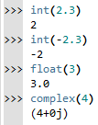
COERCION : CONVERSION OF ONE DATA TYPE INTO ANOTHER
BY USING BUILT-IN
FUNCTIONS

Slide 14
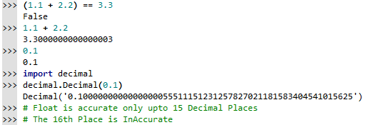

DECIMAL MODULE

Slide 15
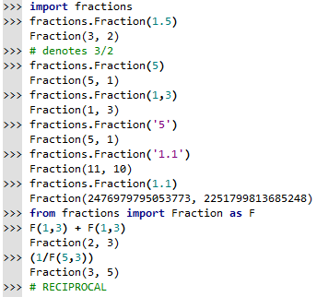
FRACTION MODULE

Slide 16
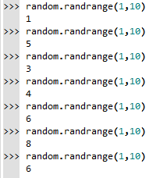
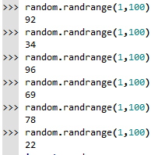


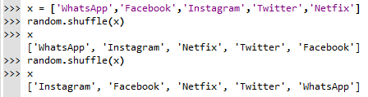
RANDOM MODULE

Slide 17

CODING IS FUN ! THANK YOU !!

